Slide 1
Final Presentation
Internship Batch: LISUM09
Data Glacier Virtual Internship 2022
Submitted by: Yihsuan Sun

Slide 2
Outline
Problem Statement
Datasets Information
EDA (Exploratory data analysis)
Model Selection and Model Building

Slide 3
Problem description & Business understanding
XYZ Credit Union, located in Latin America, does well in selling banking products such as: credit cards, deposit accounts, retirement accounts, safe deposit boxes, etc. However, after statistics, they found that their existing customers basically only buy one product, which means that the bank does not perform well in cross-selling. So XYZ Credit Union wants analysts to build models such as marketing models through machine learning to solve their problems.

Slide 4
Datasets Information
Total number of observations | 13,647,309
Total number of files | 1
Total number of features | 48
Base format of the file | csv
Size of the data | 2.13 GB
Train.csv details
Total number of observations | 929,615
Total number of files | 1
Total number of features | 24
Base format of the file | csv
Size of the data | 105 MB
Test.csv details

Slide 5
EDA (Exploratory data analysis)
EDA

Slide 6
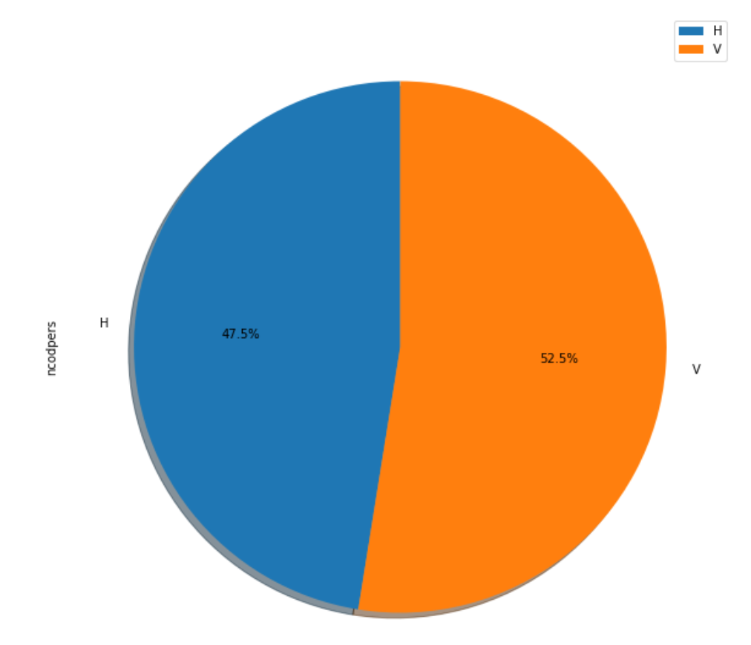
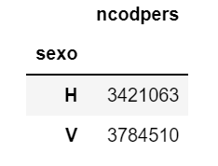
Customer's sex - Column Name : sexo

Slide 7
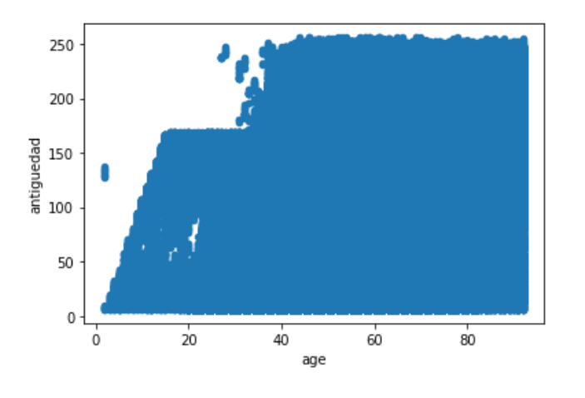
Customer's Age vs. Customer seniority (in months)

Slide 8
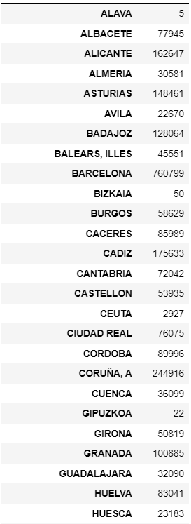
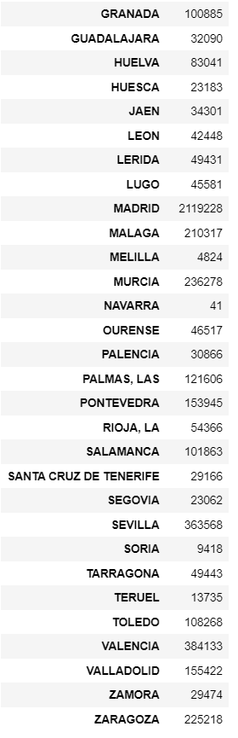
Customer's Province name (Count)

Slide 9
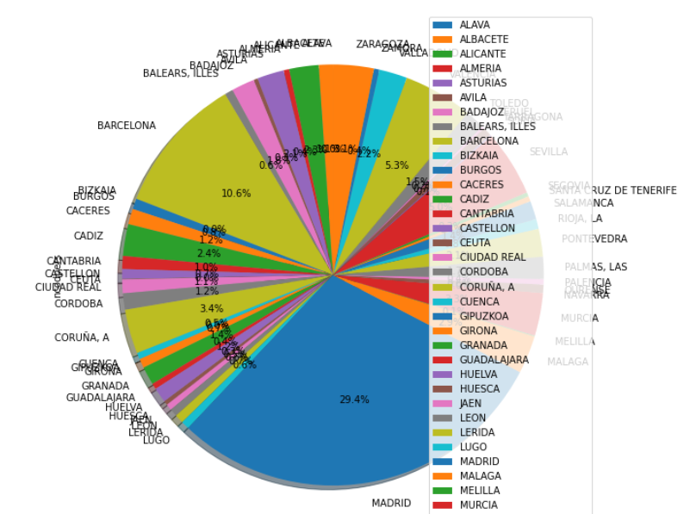
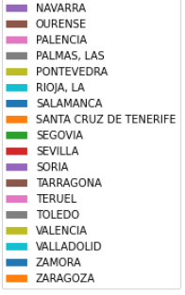
Customer's Province name (Pie chart)

Slide 10
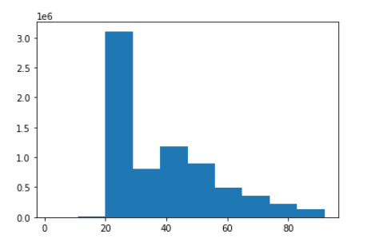
Customer’s age

Slide 11
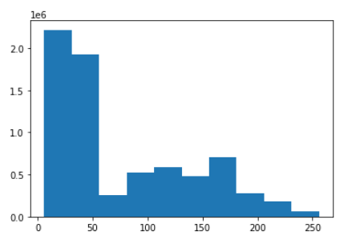
Customer seniority (in months)

Slide 12
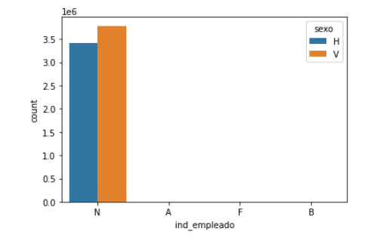
Employee index vs. Customer's sex
Employee index: A active, B ex employed, F filial, N not employee, P pasive

Slide 13
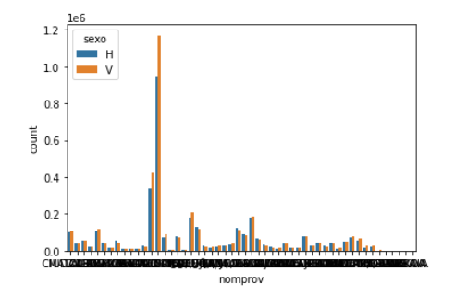
Customer's Province name vs. Customer's sex
Max count: MADRID

Slide 14
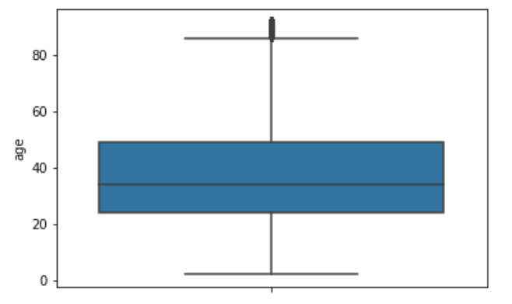
Boxplot - Age
Mean: About 35

Slide 15
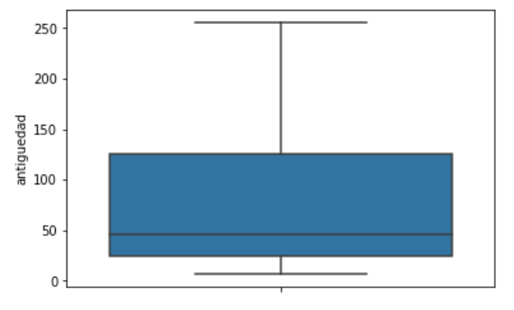
Boxplot - Customer seniority (in months)
Mean: About 50

Slide 16
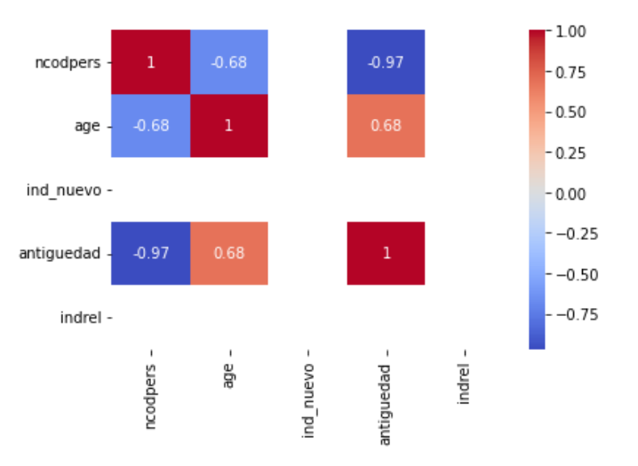
Heatmap

Slide 17
Model Selection and Model Building
Modeling

Slide 18
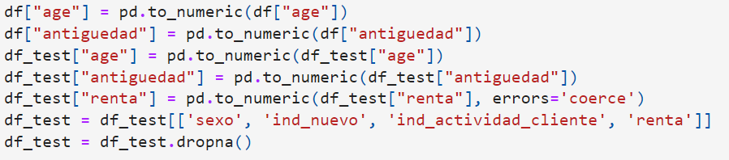
Change Data types
Change data types of "age" and "antiguedad" to numeric

Slide 19
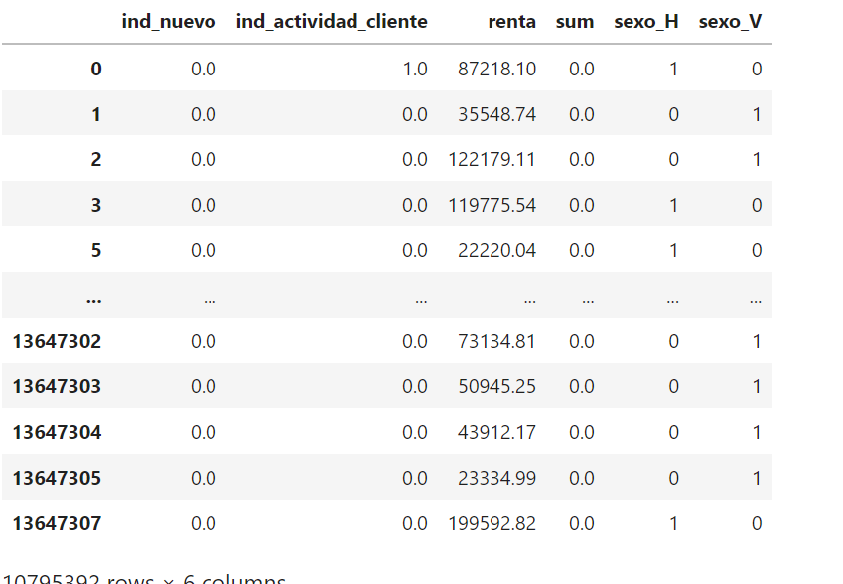
CHOOSE FEATURES TO USE IN MODELING
features= ['ind_nuevo', 'ind_actividad_cliente', 'renta', 'sexo_H']

Slide 20
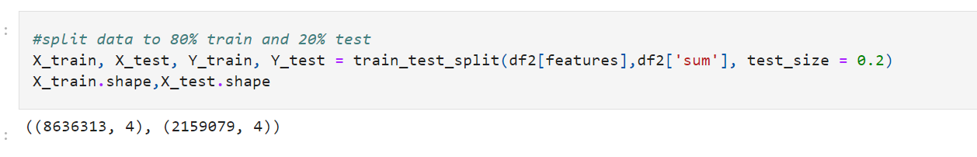
SPLIT DATA TO 80% TRAIN AND 20% TEST

Slide 21
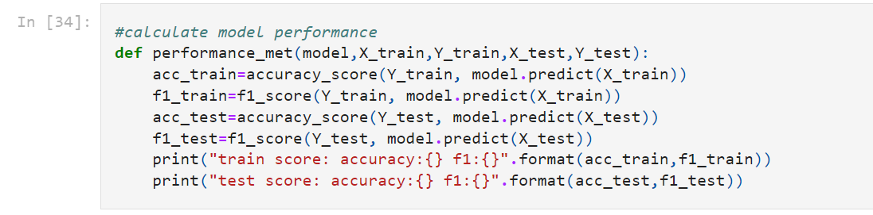
CALCULATE MODEL PERFORMANCE

Slide 22
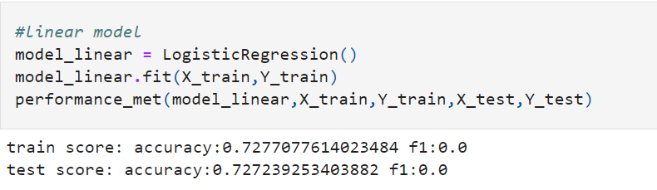
LINEAR MODEL

Slide 23
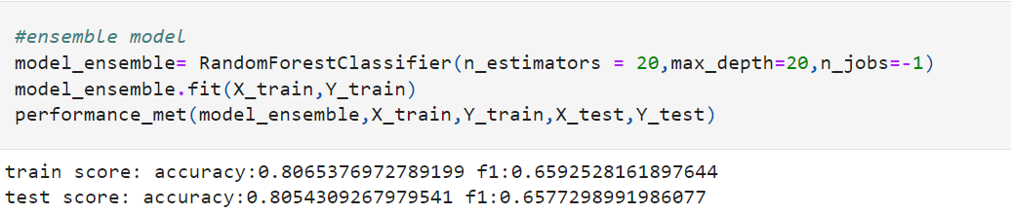
ENSEMBLE MODEL

Slide 24
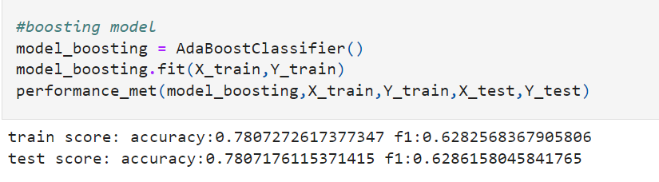
BOOSTING MODEL

Slide 25
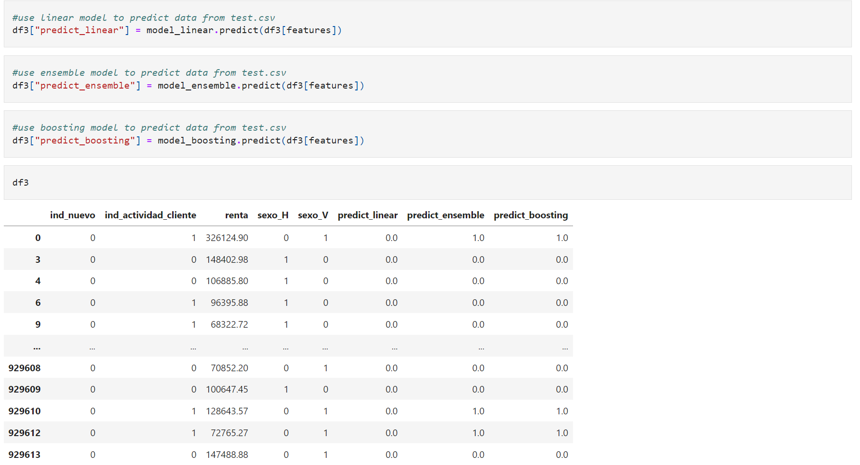
prediction

Slide 26
result
accuracy:0.80
Random Forest Classifiers provide the best result.
Accuracy ~ 80%

Slide 27
Thank you
Thank you for your listening

